Slide 1




ANALYTICS COMPETITION SUBMISSION
Delhivery Network Intelligence
Optimizing Delivery ETAs with Graph-Based Network Intelligence

Slide 2
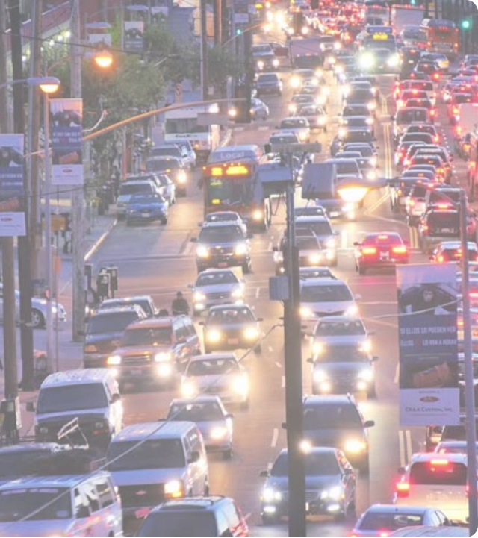


PROBLEM STATEMENT
The ETA Dilemma
SLA Breaches
Inaccurate ETA predictions cause critical SLA breaches and lower customer satisfaction.
Tabular Limitations
Baseline routing systems systematically underestimate actual travel time by nearly 2x.
Traditional tabular models ignore crucial facility processing delays and cascading network bottlenecks.
Goal: Build an intelligent, network-aware ETA prediction model.

Slide 3
Dataset & Feature Engineering
Processed 140,000+ logistics trips across the Delhivery network, establishing a rigorous data quality pipeline.
schedule
Temporal Engineering
Extracted crucial time-based signals including hour of day, day of week, and highly specific local rush hour flags.
map
Spatial Rollups
Calculated Haversine distances and mapped city pairs. Aggregated data into segment-level rollups to determine true operational time.
filter_alt
Quality & Outliers
Identified and neutralized extreme anomalies (e.g., corrupted 500+ hour delay entries) using strict IQR thresholding limits.

Slide 4



Graph Construction
Modeling the Topography
We modeled the entire logistics network as a Directed Graph using NetworkX. Unlike physical distance, Edge Weights represent the average historical delay on the corridor.
1,590
FACILITIES (NODES)
Extracted Topological Features:
PageRank: Facility importance and traffic gravity.
2,508
Betweenness Centrality: Bottleneck potential for routing.
ACTIVE CORRIDORS (EDGES)
Degree Centrality: Hub connectivity metrics.

Slide 5

Why Graph Topology Matters
Tabular models treat facilities as isolated categorical variables. Graph features mathematically expose the 'ripple effect' of congestion.
hub
Node2Vec Embeddings
Captured the structural neighborhood of each facility into dense 32-dimensional vectors, enabling deep relational learning.
groups
Community Detection
Deployed the Louvain algorithm to map hidden network structures and functional clusters within the logistics chain.
lan
Network Density
Successfully grouped facilities into 105 distinct regional sub-networks, effectively isolating local disruptions.

Slide 6

Identifying Network Bottlenecks
Computed a composite Facility Impact Score combining three dimensions to proactively isolate critical risk nodes.
hub
1. PageRank
Network Importance & Centrality
speed
2. Throughput
Physical Volume & Capacity Load
warning
3. SLA Breach %
Historical Delay Probability
Executive Insight: 370 Critical Nodes Detected
Top 5 critical nodes are responsible for >15% of all network delays.
Actionable recommendation: Focus capacity expansion at these exact hubs.

Slide 7
Model Performance Comparison
MEAN ABSOLUTE ERROR (MINUTES)
Baseline XGBoost (Tabular Only)
72.31
Node2Vec + XGBoost (Network Aware)
64.00
Graph + LightGBM (Final Champion)
62.09
14.1%
Error Reduction
0.91
R² Score
67.4%
Accuracy @ 15% Error

Slide 8




Corridor Health Distribution
Severe Delay (>50% Breach) — 35.2%
Critical Delay (30-50%) — 16.5%
2,508
Corridors
Moderate Delay (10-30%) — 41.9%
Healthy (<10%) — 6.42%

Slide 9
LOGISTICS OPTIMIZATION
FTL vs Carting Intelligence
Different vehicle types exhibit completely different delay patterns across the network topology.
local_shipping
delivery_dining
FTL (Full Truck Load)
Susceptible to highway congestion and specific hub unload delays.
Carting (Intracity Vans)
Impacted by local urban traffic and time-of-day constraints.
Interactive Vehicle Advisor
Corridors exceeding a >2.0x delay ratio are automatically flagged in the dashboard for immediate vehicle type re-allocation.

Slide 10
Executive Business Impact
dashboard
trending_up
payments
Command Center
SLA Improvement
Revenue Recovery
Deployed a 'Network Operations Command Center' Dashboard for real-time monitoring of corridors, ETAs, and bottleneck formation.
Estimated Revenue at Risk tracking enables targeted intervention.
Projected overall SLA fulfillment improvement of 20-30%.
By minimizing severe delays through routing optimization and vehicle reallocation.
Estimated revenue recovery is ₹2-5 Cr annually.

Slide 11
Strategic Roadmap & Future Scope
schedule
event_available
hub
sensors
90-Day Plan
12-Month Plan
GNN Integration
Live Intelligence
Deploy the ETA correction model API strictly across the Top 50 highest-volume corridors for immediate impact.
Execute targeted capacity expansion and infrastructure investment directed at the Top 5 Network Bottlenecks.
Implement Graph Neural Networks (GraphSAGE/GAT) to enable advanced inductive learning for unseen nodes.
Enable dynamic edge weight updates across the graph based on live, streaming traffic data APIs.

